Slide 1
Experience Kilauea
The Big Island’s Most Majestic Sight

Slide 2
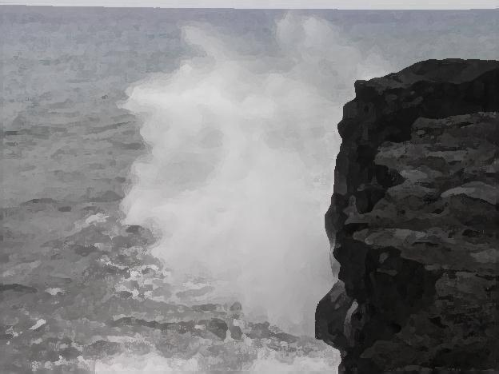
Hawaii Volcanoes National Park
Witness the forces of nature at their strongest and be inspired to learn about Hawaii’s geology, culture, and natural history.

Slide 3
Kilauea Tour Information
The tour will take you as close to the lava flows as allowed
Tour precautions
Wear sturdy, covered shoes
Expect uneven terain
You will hike with trained guides to the edge of a 2,000 degree molten lava flow

Slide 4
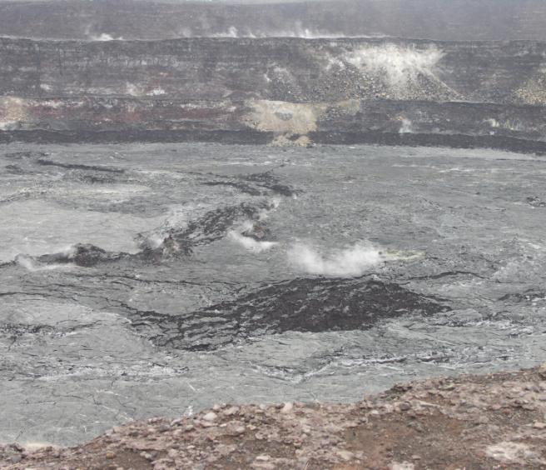
Visit the smoldering remains of Kilauea
Drive through miles of black molten lava and into Volcanoes National Park where you will experience the sight and smell of the volcano crater.

Slide 5
Kilauea Volcano Tour
Contact Lehua Hawaiian Adventures for additional information
Notes:
Recent volcanic activity at the national park site may result in changes to the tour itinerary.

